Slide 1

Academic Session 2026-27
ODD Semester July-Dec 2026
UNIVERSITY INSTITUTE OF ENGINEERING AND TECHNOLOGY
Department of TT
Bachelor of Engineering (B.E.) – CSE
Advanced Data Structures / Semester 3
(CS221)
Unit No. 1 Chapter No. 1.1 Lecture No. 4
Topic : Linear Arrays – Representation and Traversal
Abhishek Thakur (E19789) Technical Trainer
Sourav Jaiswal (E19756)-MSC Technical Trainer

Slide 2
Learning Objectives
Define a linear array and understand contiguous memory storage.
Compute the address of any element using the address formula.
Trace the traversal algorithm on a 1D array step by step.
Distinguish between row-major and column-major 2D array layouts.

Slide 3
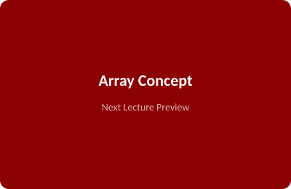
What is a Linear Array?
Array: A fixed-size, ordered collection of elements of the same data type stored in contiguous memory.
Homogeneous: All elements share the same data type (e.g. all int, all float).
Index-based: Each element is accessed in O(1) time using its index (0-indexed in C).
Static: Size must be declared at compile time; cannot grow or shrink dynamically.
Operations: Traversal, Insertion, Deletion, Searching, Sorting.

Slide 4
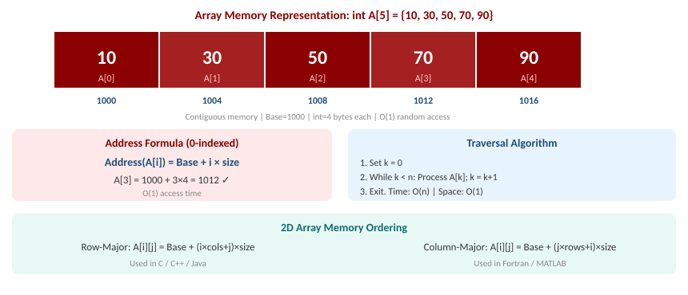
Array Memory Representation, Address Formula & Traversal

Slide 5
Summary of the Lecture
Arrays store elements in contiguous memory, accessible via index in O(1) time.
Address formula (0-indexed): Address(A[i]) = Base + i × element_size.
Traversal visits every element from index 0 to n-1 in O(n) time, O(1) space.
2D Row-Major: A[i][j] = Base + (i x cols + j) x size — used in C/C++.
2D Column-Major: A[i][j] = Base + (j x rows + i) x size — used in Fortran.

Slide 6
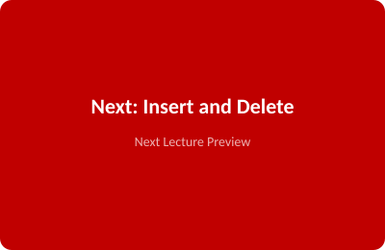
Next Lecture
Insertion and Deletion in Arrays – algorithms, step-by-step trace, and complexity.

Slide 7
Quiz/ FAQ's
Q1. Given int A[6] with Base=2000, compute the address of A[4]. (int = 4 bytes)
Q2. Write the pseudocode algorithm for traversing a 1D array of n elements.
Q3. How does row-major order differ from column-major order in 2D arrays?

Slide 8
References/ Articles
Seymour Lipschutz, Data Structures, Schaum's Outlines, McGraw-Hill, Ch. 4.
Reema Thareja, Data Structures Using C, Oxford University Press, Ch. 3.
GeeksforGeeks – Arrays in C/C++: https://www.geeksforgeeks.org/arrays-in-c-cpp/

Slide 9
Thank You
For queries
Email: abhishek.e19789@cumail.in

